Slide 1
Inheritance and OO design
CSS 343: Data Structures, Algorithms, and Discrete Mathematics II
Version 1
Wooyoung Kim

Slide 2
Inheritance - review
Parent class (base class)
Not necessarily tree structure: can have more than 1 parent (multiple)
Child class (derived class)

Slide 3
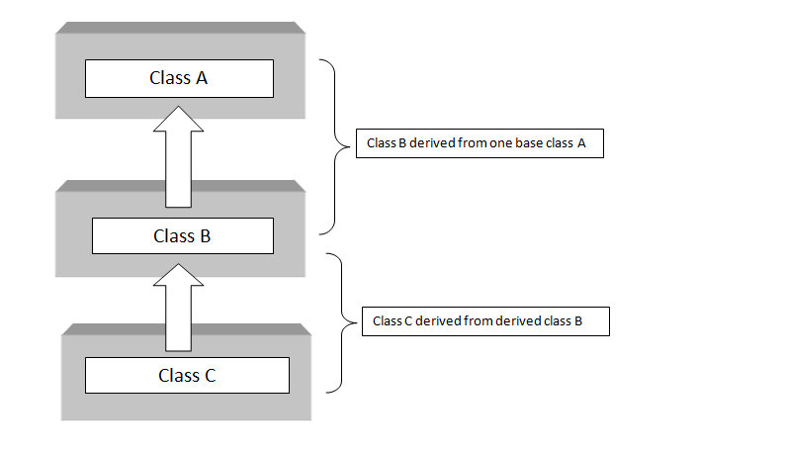
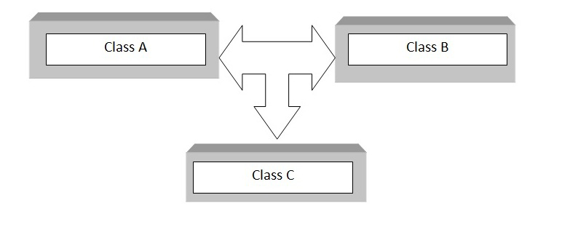
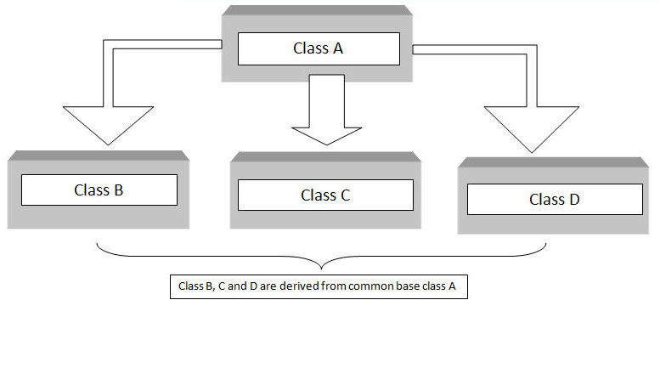
Inheritance - types
Single inheritance: A class inheriting a base class
Multilevel inheritance:
Multiple: A class can inherit from more than one classes.
Hierarchical inheritance: When several classes are derived from common base class
multilevel
multiple
hierarchical

Slide 4
Inheritance - example
class Person{
public:
string getName() const;
void display() const {cout<<"base class"<<endl;};
private:
string name;
};
class Student : public Person {
public:
float getGPA() const;
void display() const {cout<<"derived class"<<endl;};
private:
float gpa;
};

Slide 5
Inheritance - example
class Person{
public:
string getName() const;
void display() const {cout<<"base class"<<endl;};
private:
string name;
};
class Student : public Person {
public:
float getGPA() const;
void display() const {cout<<"derived class"<<endl;};
private:
float gpa;
};
// legal or illegal?
Case1:
Student *P = new Person
Case2:
Person p;
Student s = p

Slide 6
Inheritance - example
class Person{
public:
string getName() const;
void display() const {cout<<"base class"<<endl;};
private:
string name;
};
class Student : public Person {
public:
float getGPA() const;
void display() const {cout<<"derived class"<<endl;};
private:
float gpa;
};
Both illegal
Case2:
Person p;
Student s = p
Case1:
Student *P = new Person
Every object of the derived class is also an object of the base class, but not vice versa.
Derived class needs more space than base class in general. Person *p=new Student

Slide 7
Inheritance - example
class B : public A {
// x is
// y is
// z is
};
class A {
public: int x;
protected: int y;
private: int z;
};
class C : protected A {
// x is
// y is
// z is
};
class D : private A {
// x is
// y is
// z is
};
class B : A
What is the default access type?

Slide 8
Inheritance - example
All public methods in the class A remain [ ] in the derived class
class B : public A {
// x is public
// y is protected
// z is not accessible
};
class A {
public: int x;
protected: int y;
private: int z;
};
class C : protected A {
// x is protected
// y is protected
// z is not accessible
};
class D : private A {
// x is private
// y is private
// z is not accessible
};
class B : A
➔ class B : private A

Slide 9
Inheritance - override
class Person{
public:
void display() const {cout<<"base class"<<endl;};
private:
string name;
};
class Student : public Person {
public:
float getGPA() const;
void display()const {cout<<"derived class"<<endl;};
private:
float gpa;
};
int main() {
Student s;
s.display();
Person *p;
p = new Student;
p->display();
}
What are the output of the main?

Slide 10
Inheritance - override
class Person{
public:
void display() const {cout<<"base class"<<endl;}
private:
string name;
};
class Student : public Person {
public:
float getGPA() const;
void display()const {cout<<"derived class"<<endl;}
private:
float gpa;
};
int main() {
Student s;
s.display();
Person *p;
p = new Student;
p->display();
}
What are the output of the main?
derived class
base class
How to force to use Student’s display() ?→ USE virtual

Slide 11
Polymorphism
Polymorphism: Refer to objects of different types (override)
For unknown type, the base class function is called (static binding – compiler time binding) : How to force to use derived class function?
Virtual function: Allow us to implement polymorphism (dynamic binding – run time binding)
Virtualness is always inherited: If base class function is virtual, derived class functions are implicitly virtual.
class Person {
public:
…
virtual void display();
..
Base class (required)
class Student:public Person{
public:
…
virtual void display();
..
class Student:public Person{
public:
…
void display();
..
Derived class (option)

Slide 12
Note for Virtual function
With dynamic binding, the most specific definition of the operation is used (the last descendant class)
Constructors are never virtual
When an object of a derived class is declared, the constructors of both base and derived classes are executed.
Destructors should be virtual if memory is allocated (even if it is static) in any derived class to avoid memory leaks

Slide 13
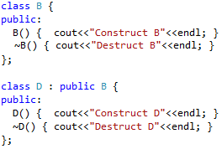


Constructor & Destructor
What will happen
How about

Slide 14
Constructor & Destructor
What will happen
How about
Construct B
Construct D
Destruct D
Destruct B
How to fix?
Construct B
Construct D
Destruct B
make destructor virtual

Slide 15
Pure Virtual
Pure virtual function: has “=0” in the declaration
“=0” is just the indication of pure virtual function (Not that it assigns value 0)
All derived classes should implement the method
Pure virtual function can have implementation on the base class?
Yes. But it is a rare case such as, if all the derived class want to have some default implementation
class Person {
public:
…
virtual void display() = 0;
..

Slide 16
Abstract class
Abstract class: any class with a pure virtual function : never instantiate an abstract class
Example, if Person is an abstract class,
Person P;
Person *P = new Person;
Person * P = new Student;
What is legal?
Any derived class from an abstract class that doesn't implement all virtual functions is also an abstract class

Slide 17
Abstract class
Abstract class: any class with a pure virtual function : never instantiate an abstract class
Example, if Person is an abstract class,
Person P;
Person *P = new Person;
Person * P = new Student;
What is legal?
Any derived class from an abstract class that doesn’t implement all virtual functions is also an abstract class
Person * P = new Student

Slide 18
Review-Friends
Functions and classes can be friends of a class C
Friend functions are not members of the class C
Friend functions can access the private and protected values of the class C
Methods of a friend class have access to the private and protected parts of the class C
Notes:
A friend function is a function that can access the non-public members of a class, but the function itself is not a member of the class.

Slide 19
Review-Friend data and function
Class Me{
friend function f1;
friend class c1;
};
- f1 can use all the private value of Me
- c1 can access all the private members of Me
(C++ book, p 421)
Notes:
Child is Me’s derived class.
Can c1 access Child’s private (protected) members? – No.

Slide 20
More issues
Parameter types are always determined statically (at compile-time)
ostream &operator<<(ostream &out, const Person &p); ---1
ostream &operator<<(ostream &out, const Student &s); ----2
Person *p = new Student;
cout << *p;
Which will be called?

Slide 21
More issues
Parameter types are always determined statically (at compile-time)
ostream &operator<<(ostream &out, const Person &p); ---1
ostream &operator<<(ostream &out, const Student &s); ----2
Person *p = new Student;
cout << *p;
Which will be called? 1
How to fix?
Call a virtual print function
Casting:
cout<<static_cast<Student &>(*p)<<endl;
friend function cannot be declared virtual.
If F is a friend of a base class, F is not necessarily a friend of the derived class.
But F get access to the inherited attributes of the derived class.

Slide 22
#include <iostream>
class Derived;
class Base {
private:
int base_x;
public:
Base(int x) : base_x(x) {}
friend void show_x(Base& b, Derived& d);
};
class Derived : public Base {
private:
int derived_x;
public:
Derived(int x1, int x2) : Base(x1), derived_x(x2) {}
};
void show_x(Base& b, Derived& d) {
std::cout << b.base_x << ' ' << d.base_x << std::endl;
}
int main() {
Derived d(10, 20);
show_x(d, d);
return 0;
}
(1) What if we change this to d.derive_x? Would it compile?
(2) Would it compile?
(3) What is the output?
Notes:
Not compile. Friend method is base’s friend, not Derived’s class. So cannot access to derived_x, which is a private of Derived class
Compile. Since show_x is the friend method, can access Base’s private data. Although Derived cannot access Base’s private data, the friend method can access through Derived class as it is inherited attribution.
The output is, 10,10
How about?
Base *b = new Derived(20,30);
show_x(*b, *b);
How to fix?
show_x(*b, static_cast<Derived &>(*b));

Slide 23
More issues
Using call-by-value with polymorphic data can result in “______” of data.
Student s; Person p=s;
Don’t make the destructor pure virtual. It is a special cases where the base method is always called.
Review: How about this case?
Person p; Student s = p
Notes:
Person p; Student s = p
Will have compile error

Slide 24
More issues
Using call-by-value with polymorphic data can result in “slicing” of data. Why?
Student s; Person p=s;
Since derived class is usually larger. The object “p” does not get the s’s gpa.
Then will lose some of attributes of students
Don’t make the destructor pure virtual. It is a special cases where the base method is always called.
Review: How about this case?
Person p; Student s = p
Compile ERROR!
Notes:
Person p; Student s = p
Will have compile error

Slide 25
Casting
To override a function, should use the exact same prototype.
Can you override?
bool Person::operator<(const Person &P) const;
With
bool Person::operator<(const Student&P) const;
Answer is no: it is overloaded, not overridden.
Implicitly cast from the derived class to the base class, not vice versa. (Student s; Parent p; p=s;)
Example
bool Student::operator<(const Person&P) const
{
const Student &s=static_cast<const Student &>(p);
return gpa<s.gpa;
}

Slide 26
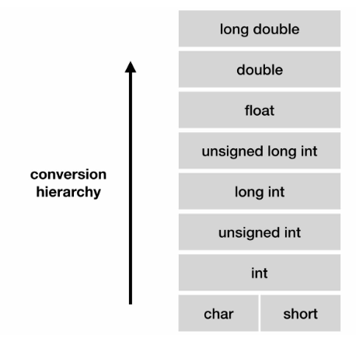
C++ Casting
Implicit conversion: conversions are performed automatically by the compiler.
short a=2000; int b; b=a;
2. Explicit conversion:
static_cast (usually reference)
static_cast<type>(expression)
dynamic_cast: (only with pointers and references)
dynamic_cast<type>(expression);
reinterpret_cast; const_cast
https://www.teksmart.in/2018/10/c-casting.html
Note: If derived class point to an incomplete base class, it could lead to run time errors if de-referenced

Slide 27
Dynamic casting
class Person { virtual void display() {cout<<“Person”<<endl;} };
class Student: public Person {void display() {cout<<“Student”<<endl;} int a; };
int main () {
try { Person * ps = new Student;
Person * pp = new Person;
Student * sd;
sd = dynamic_cast<Student*>(ps);
if (sd==0) {
cout << "Null pointer on first type-cast" << endl;
}
else sd->display();
sd = dynamic_cast<Student*>(pp);
if (sd==0) {
cout << "Null pointer on second type-cast" << endl;
}
else sd->display();
} catch (exception& e) {cout << "Exception: " << e.what();}
}
What is output?

Slide 28
Dynamic casting
It can cast null pointers when performed unrelated classes
class Person { virtual void display() {cout<<“Person:”;} };
class Student: public Person {void display() {cout<<“Student:”;} int a; };
int main () {
try { Person * ps = new Student;
Person * pp = new Person;
Student * sd;
sd = dynamic_cast<Student*>(ps);
if (sd==0) {
cout << "Null pointer on first type-cast" << endl;
}
else sd->display();
sd = dynamic_cast<Student*>(pp);
if (sd==0) {
cout << "Null pointer on second type-cast" << endl;
}
else sd->display();
} catch (exception& e) {cout << "Exception: " << e.what();}
}
What is output? Student: Null pointer on second type-cast
Useful with multiple derived class, can check the right cast

Slide 29
OO Design

Slide 30
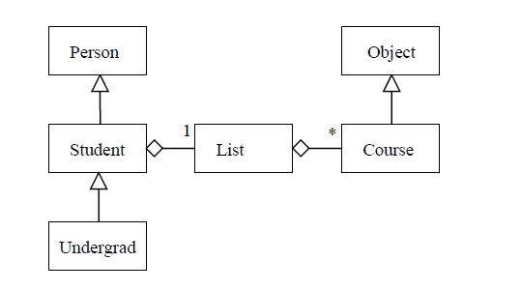
OO Design - UML
UML (Unified Modeling Language)
Class
“has-a” (Library has book as a member)
Aggregation – has owner but doesn’t die with owner
Composition – gone with the owner
Multiplicity
“is-a” relationship – inheritance
Aggregation
has
Library
Lib
Book
has
Composition
Page
Is a
has a
has
Is a

Slide 31
SOLID Principles
Single responsibility
a class should have only a single responsibility
Open/closed
"software entities should be open for extension, but closed for modification."
Liskov substitution
objects can always be replaced with instances of their subtypes
Interface segregation
many interfaces are better than one general-purpose interface
Dependency inversion principle
Abstractions should not depend on details.
Details should depend on abstractions.

Slide 32
Open closed principle
A class should be open for extension, but closed for modification
How? Inheritance and polymorphism
Example: Store class, and different types of items
How can we add more items? → Inheritance

Slide 33
Liskov Substitution principle
Subclasses should be substitutable for their base classes
Key idea: derived classes should inherit all the behaviors of the base class
Which one should be a base class? Square or Rectangle?
Use precondition/postcondition
A derived class method should have preconditions that are no stronger than the base class method it overrides
A derived class method should have postconditions that are no weaker than the base class method it overrides

Slide 34
More about design
Traditional noun identification – First try
Noun – objects, data
Verb - functions
An ATM is an electronic device designed for automatically serving users. A card holder can view balance, deposit, or withdraw money in accounts. Customers interact with the system through a simple interface consisting of a card reader and a numeric keypad …
May be refined
Duplicates (users, card holder, customers) -> merge
Get rid of or revisit/revise too big, general, out of scope terms (ATM, electronic device, money, system)
Get rid of “too small” words (balance – attribute?)
Some may be actors (customer)
May (optionally) add business logic (manager) class, data structure ADT

Slide 35
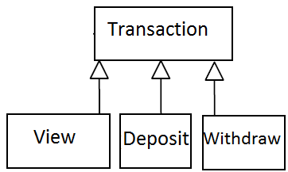
More about design (cont.)
How about transactions: view, deposit, withdraw? - practice
Switch or if-else in business logic class?
Violates open-close principle
Open-close principle
A class should be open for extension, but closed for modification
be able to extend classes, without requiring the class to be modified
not always possible to achieve, but you should try to when possible
Less intuitive inheritance: verbs become classes
Optional reading: design pattern, command pattern (Files/additional Materials on Canvas)
Transaction *t;
t->doTransaction();

Slide 36
What is Design Pattern
A pattern:
Describes a recurring problem
Describes the core of a solution (“essence”)
Is capable of generating many distinct designs (sufficiently abstract to be reusable in different contexts)

Slide 37
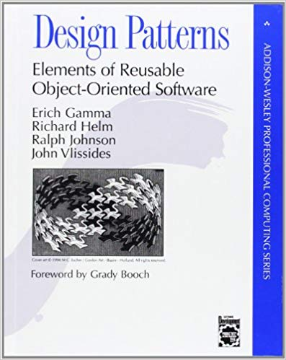
Design Patterns
Good Sources:
https://sourcemaking.com/design_patterns
https://www.oodesign.com/
https://en.wikibooks.org/wiki/C%2B%2B_Programming/Code/Design_Patterns
Not an algorithm, a way to address a common design problem
Discussing patterns → higher level discussion, rather than code
Design Patterns: Elements of Reusable Object-Oriented Software (1994) by Gamma, Helm, Johnson and Vlissides, known as the Gang of Four (GoF).
Creation Pattern
Behaviour Patterns
Structural Patterns
Notes:
Creational: Singleton, Factory Method, Abstract Factory, Builder, Prototype
Structural: Adapter, Bridge, Composite, Decorator, Façade, Flyweight, Proxy
Behavioral: Chain of Responsibility, Command, Interpreter, Iterator, Mediator, Memento, Observer, State, Strategy, Template Method, Visitor

Slide 38
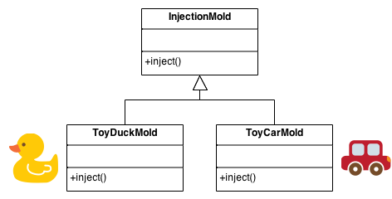
Creation Patterns: Factory
Intent
Define an interface for creating an object, but let subclasses decide which class to instantiate.
Do not expose the instantiation logic to the client
Defining a "virtual" constructor.
Newly created objects accessed through a common interface
Problem
A framework needs to work for a range of applications, but allow for individual applications to define their own objects
Examples
graphics -- Shape class instantiates and returns objects. Use draw, move, resize without knowing the underlying type. Add new shapes without changing existing code
java.net.URLConnection - allows users to decide which protocol to use

Slide 39
class Stooge { public: virtual void slap_stick() = 0; }; class Larry: public Stooge { public: void slap_stick() { cout << "Larry: poke eyes\n"; } }; class Moe: public Stooge { … } class Curly: public Stooge { … }
int main(){ vector<Stooge*> roles; int choice;
while (true){
cin>> choice;
if (choice ==0) break;
else if (choice = 1)
roles.push_back(new Larry);
….
}

Slide 40
Further improvement – Factory method pattern
In general: can be used with an inheritance hierarchy to instantiate the object based on input and return the pointer
For the Transaction example:
Return a Transaction pointer
Can be reused anywhere an object of Transaction needed to be created
Related to assignment 4
Where can we use factory method? – practice with your design group members (if haven’t set up your group, set up now!!)

Slide 41
Question banks
https://www.sanfoundry.com/cpp-programming-questions-answers-multiple-inheritance/
https://www.geeksforgeeks.org/c-plus-plus-gq/inheritance-gq/

